Slide 1

Leaf Development
Software Architecture
Styles: Service Oriented
And Peer to Peer
Maria Cortes - V&V Lead
Manuel Dosal – Systems Designer
Mario Flores - Lead Programmer 1
Rebekah Gruver – Programmer 2
Hector Quintana – Systems Architect
Marcela Vazquez - Systems Analyst

Slide 2
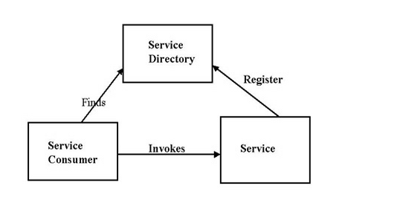
Service Oriented
What is it?
Service-oriented architecture is a client/server design approach in which an application consists of a collection of software services and software service consumers [1].
These services communicate with each other: Two roles a service provider and a service consumer.

Slide 3
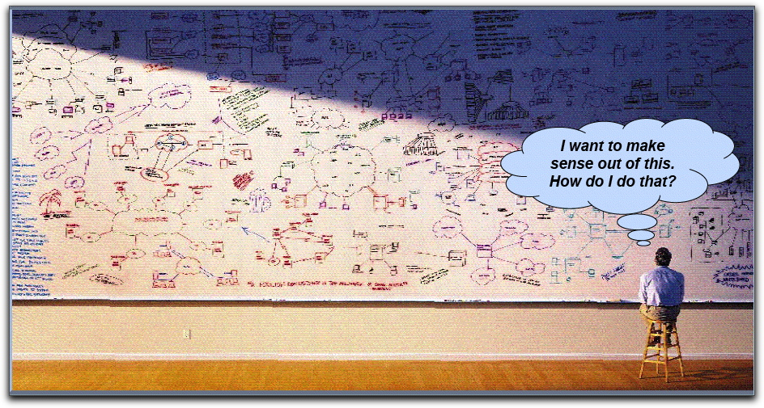
Service Oriented
Problems Addressed by a Service Oriented Architecture
Promote Reusability of Code
Maintainability
Extendibility

Slide 4
Service Oriented
Elements
Application frontend
Active elements of the architecture, delivering the value to the end users. It initiates and control all activity of the enterprise system. Web application, application with GUI, or a batch application.
Service
A software component that encapsulates a high level business concept.
Service repository
It registers the services and their attributes to facilitate the discovery of services; operation, access rights, owner, or qualities.
Service Bus
A flexible infrastructure for integrating applications and services by : routing messages, transforming protocols between requestor and service, handling business events and delivering them. It provides mediation and security.
Contract
Provides a specification of the purpose, functionality, constraints, and usage of services.
Implementation
The service implementation provides the required business logic and appropriate data. It contains one or more of the artifacts: programs, configuration, data and databases.
Interface
Functionality exposed by the service to the clients that are connected to it.
Business logic
Business process represented by the service.
Data
Data represented in the service and used by it.

Slide 5
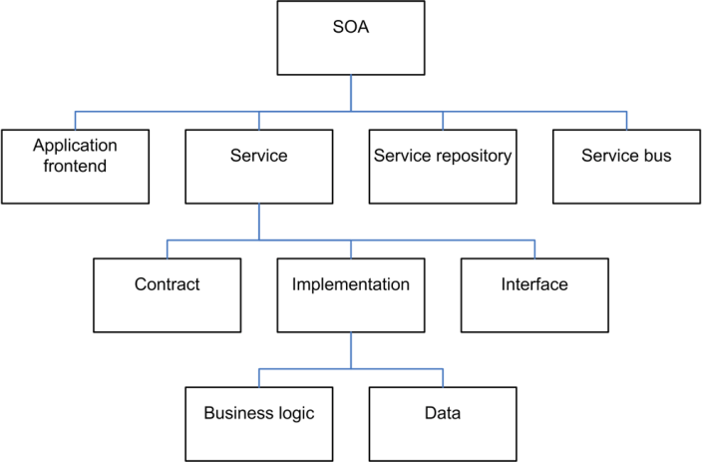
Service Oriented
Elements

Slide 6
Service Oriented
Strengths
Modularity
Reusability
Extendibility
Parallelism
Weaknesses
Development overhead
Latency
Dependency

Slide 7
Examples
Service Oriented
VisKo
VisKo uses transformation services to visualize data. Each service is independent and can services can be added or deleted.
Web Services
Each protocol was designed with the Service Oriented Architecture style in mind.

Slide 8
Peer to Peer
What is it?
Peer-to-peer it’s a type of architectural network that depends only on its clients. A server doesn’t exist for this architecture to work, because every client has access to each other client.

Slide 9
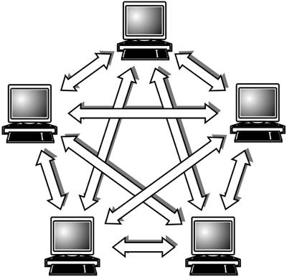
Peer to Peer
What problem does it solve?
Peer-to-peer gets rid of having a main server receiving and delivering all the requests at once, instead the workload is distributed to all clients. Its rudimentary architecture made it possible for the internet to exist in the very beginning. [3]
How does it solve the problem?
It does not required a centralized server that hosts its files, since everyone has access to each other’s files through FTP (File Transfer Protocol). [4]

Slide 10
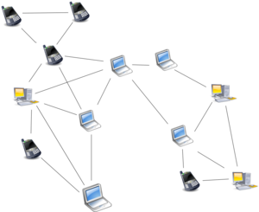
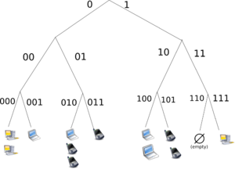
Peer to Peer
Elements
Components: Nodes that function both as clients and servers
Connectors: Data is exchanged between nodes through a TCP/IP network
Topology:
Structured Networks – Hash Table/Tree Sort
Because of the specific topology, any node
can efficiently search for a particular resource
on the network
Caution: Less robust in networks with a high rate
Unstructured Networks – Random Overlay
Nodes that randomly form connections
with each other

Slide 11
Peer to Peer
Strengths and Weaknesses
Its biggest strength is the lack of need for a server, where users are allowed to do anything they want without the consent of a server. Which can be also a potential drawback, because applications work as a host and a client at the same time, they are prone to attacks.

Slide 12
Examples
Peer to Peer
Most modern applications still follow the early type of programs like Napster. They use peer-to-peer are related to sharing files, most of the time illegally.
Another modern application is digital currencies, where every client owns a wallet with currency that only exists on every client’s wallet. Kind of like real money, every person has money that is validated once you buy something and it’s taken away from you.

Slide 13
References
Resources
[1] http://www.indiawebdevelopers.com/resource_center/articles/soa.html
[2] http://en.wikipedia.org/wiki/Service-oriented_architecture
[3] http://iml.jou.ufl.edu/projects/fall02/moody/history.html
[4] http://www.cato.org/publications/policy-analysis/peerpeer-networking-digital-rights-management-how-market-tools-can-solve-copyright-problems

Slide 14

Questions?

